Slide 1
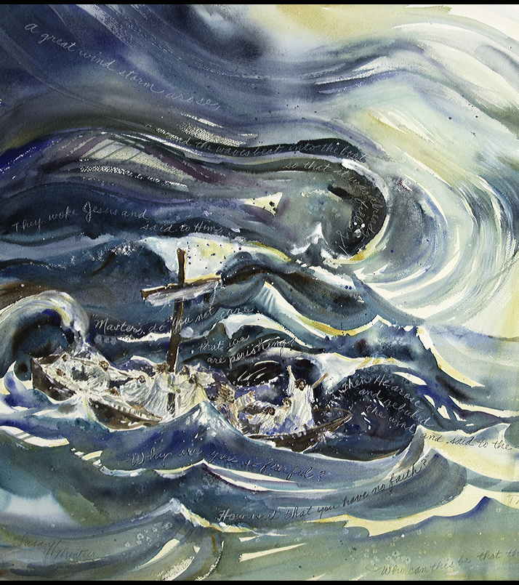
Moving at the lord’s command mark 4:35-40

Slide 2
³⁵ On the same day, when evening had come, He said to them, “Let us cross over to the other side.” ³⁶ Now when they had left the multitude, they took Him along in the boat as He was. And other little boats were also with Him. ³⁷ And a great windstorm arose, and the waves beat into the boat, so that it was already filling.

Slide 3
³⁸ But He was in the stern, asleep on a pillow. And they awoke Him and said to Him, “Teacher, do You not care that we are perishing?”
³⁹ Then He arose and rebuked the wind, and said to the sea, “Peace,^{[a]} be still!” And the wind ceased and there was a great calm. ⁴⁰ But He said to them, “Why are you so fearful? How^{[b]} is it that you have no faith?”
.

Slide 4
MOVING ON IS AN IMPORTANT PART OF LIFE

Slide 5
THE CHRISTIAN LIFE IS A “MOVE FORWARD” LIFESTYLE.

Slide 6
I. THE SPECIFIC COMMAND TO MOVE ON
“Let us cross over to the other side.” (v. 38)

Slide 7
The Christian life is a “journey” our movement must be toward progress

Slide 8
ii. When we move at his command certain things will be experience

Slide 9
Jesus may seem indifferent to our pleas
(v38) “ASLEEP ON A PILLOW AND THEY AWOKE HIM…”

Slide 10
THE MOST IMPORTANT THINGS TO KNOW IS THAT JESUS WAS IN THE BOAT
(V.36) “THEY TOOK HIM ALONG IN THE BOAT”

Slide 11
THE STORM EXPOSED THE FEARS AND ABSENCE OF FAITH (v.40)

Slide 12
iii. Four (4) practical things we should do as we “pass unto the other side”

Slide 13
a. Have the courage to change. rom. 12:2; phil. 4:13

Slide 14
*forsaking any known sin in your life.
*get out of bad habit.
*let the holy spirit give you transformation.

Slide 15
*have the courage to change careers/jobs
*start a new project of business.

Slide 16
b. Always be thankful. col. 3:15
¹⁵ And let the peace of God rule in your hearts, to which also you were called in one body; and be thankful.

Slide 17
c. Have the determination to grow spiritually.
2 pet. 3:14-16

Slide 18
d. Be willing to serve others in Jesus’ name.

Slide 19
“only one life will soon be past, only what’s done for Christ will last”
-ct studd

Slide 20
Conclusion:
“and they came over unto the other side…”
Mark 5:1

